Slide 1
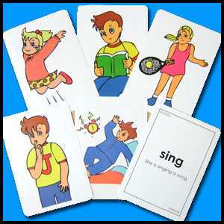
ACTION VERBS AND ABILITIES
I
can
read.

Slide 2
I can sing.
I can’t drive.
CAN
+VERB
CAN’T

Slide 3
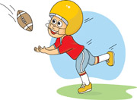
Catch a ball

Slide 4
Cook

Slide 5
Dance

Slide 6
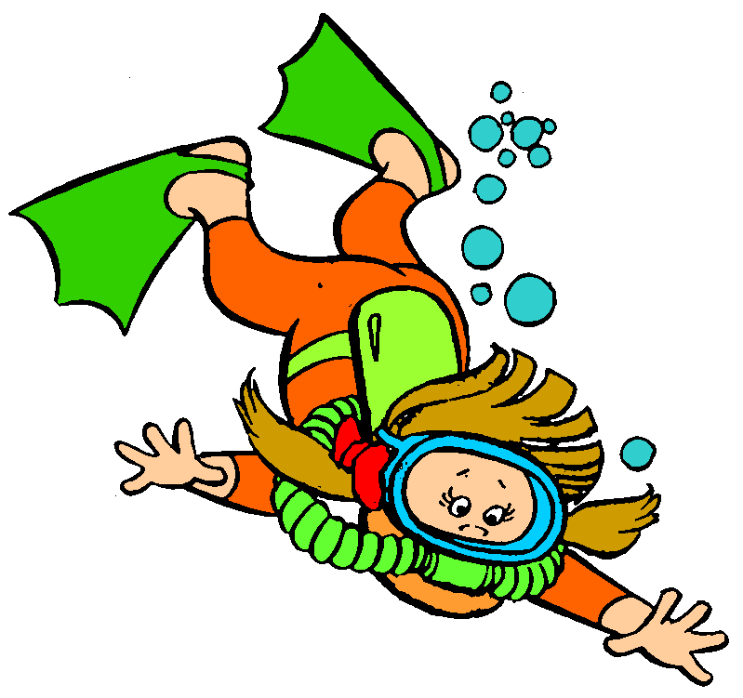
Dive

Slide 7
Do gymnastics

Slide 8
Do karate

Slide 9
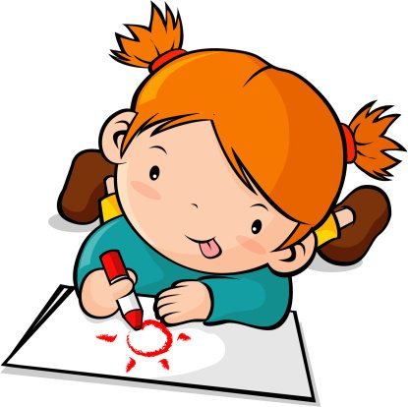
Draw

Slide 10
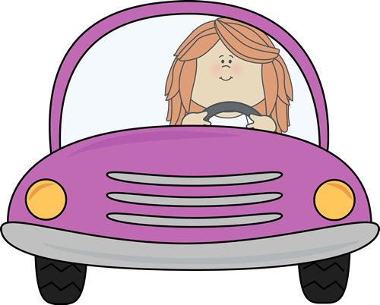
Drive

Slide 11
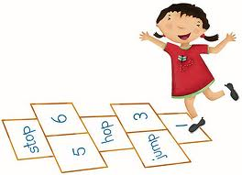
Hop

Slide 12
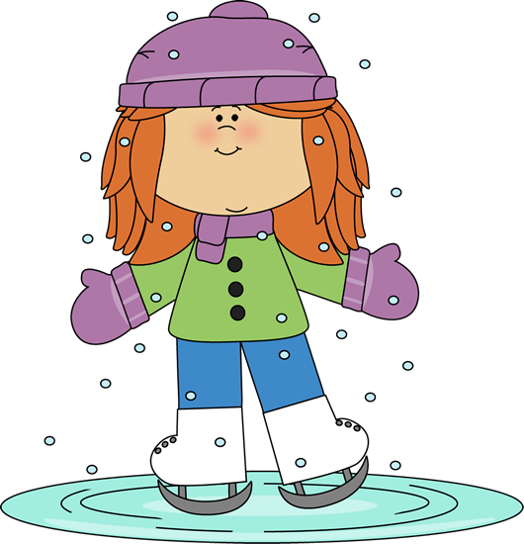
Ice-skate

Slide 13
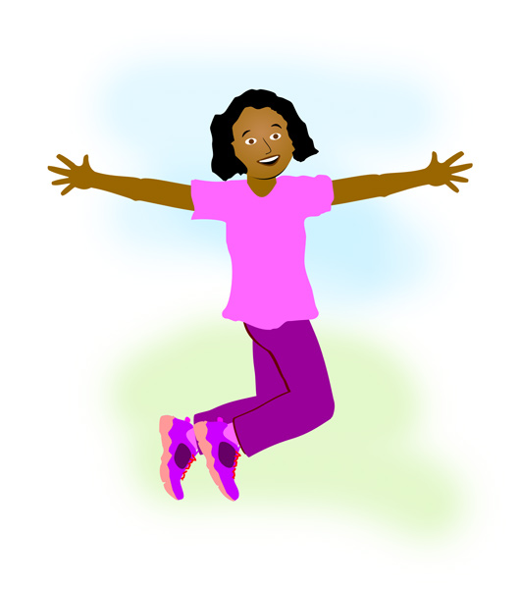
Jump

Slide 14
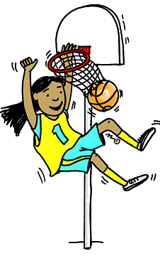
Play basketball

Slide 15
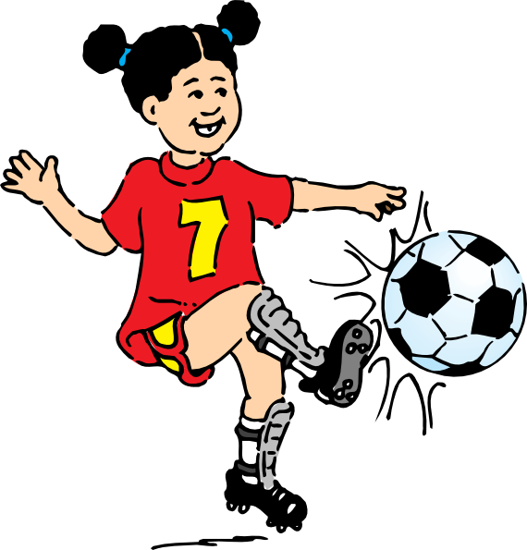
Play football

Slide 16
Play tennis

Slide 17
Play the guitar

Slide 18
Read

Slide 19
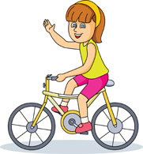
Ride a bike

Slide 20
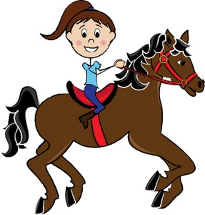
Ride a horse

Slide 21
Rollerblade

Slide 22
Run

Slide 23
Sing

Slide 24
Ski

Slide 25
Swim

Slide 26
Write

Slide 27
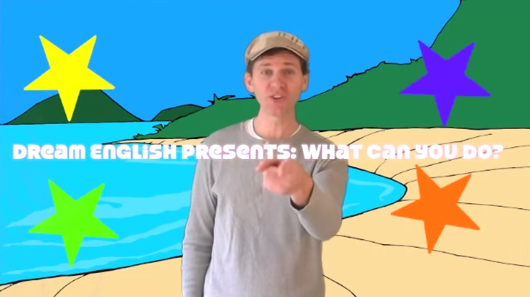
SONG: What can you do?

Slide 28
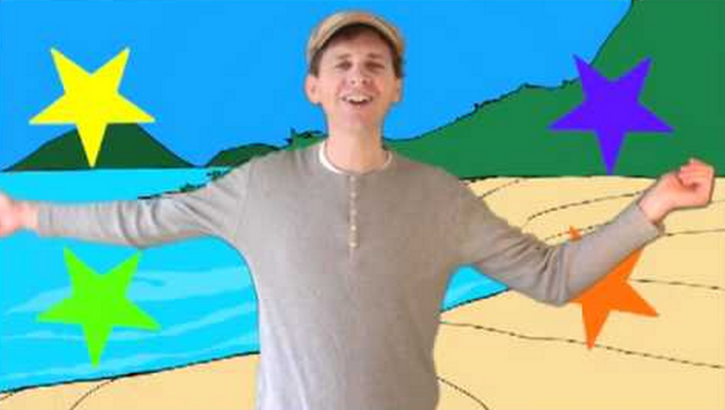
How about you?
What can
you do?

Slide 29
SONG: What can you do?

Slide 30
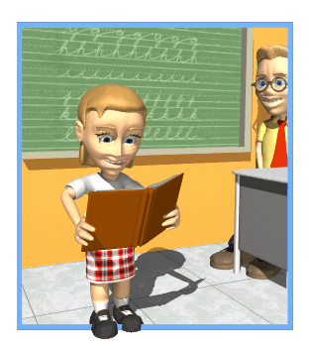
GAME: Mime & Guess
What can I do?
You can read.

