Slide 1
jobs

Slide 2
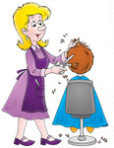
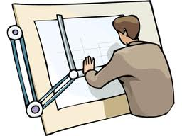
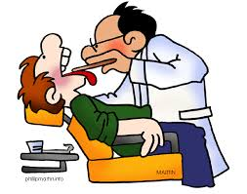
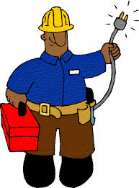
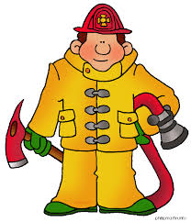
architec
nurse
doctor
hairdresser
engineer
waiter
police officer
dentist
postman
electrician
mechanic
firefighter

Slide 3
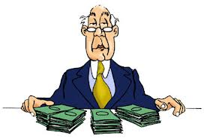
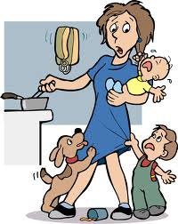
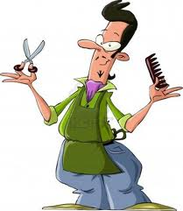
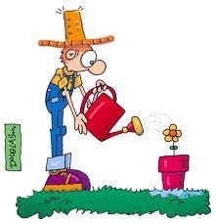
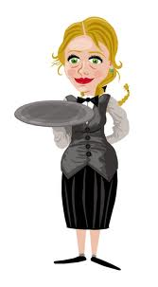
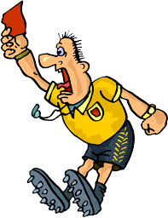
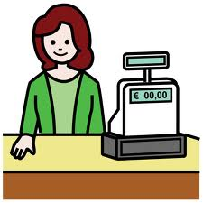
bus driver
accountant
student
singer
housewife
barber
gardener
waitress
referee
cashier
workman
priest

Slide 4
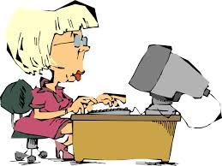
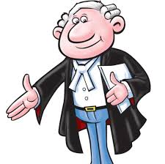
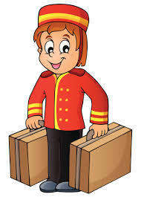
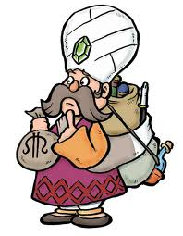
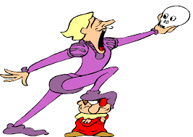
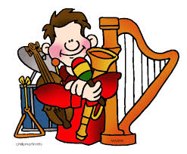
secretary
lawyer
sales person
bell boy
pilot
astronaut
fly attendant
merchant
carpenter
chef
actor
musician

Slide 5
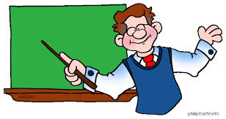
work with plants, trees and with soil
fix your hair
teach in a school
design houses

Slide 6
take orders from menus
take you anywhere in the city
walk in the space
sell what the coustomer needs

Slide 7
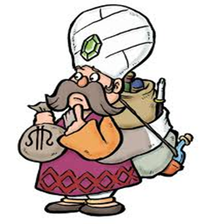
catch criminals
help you travel comfortably by plane
deal with goods
cure sick people

Slide 8
work on a computer
extinguish fires
work with laws
fly big planes

Slide 9
carry lugagge
act in a theater
help doctors operate on patients
sing very well

Slide 10
Well done!

