Slide 1
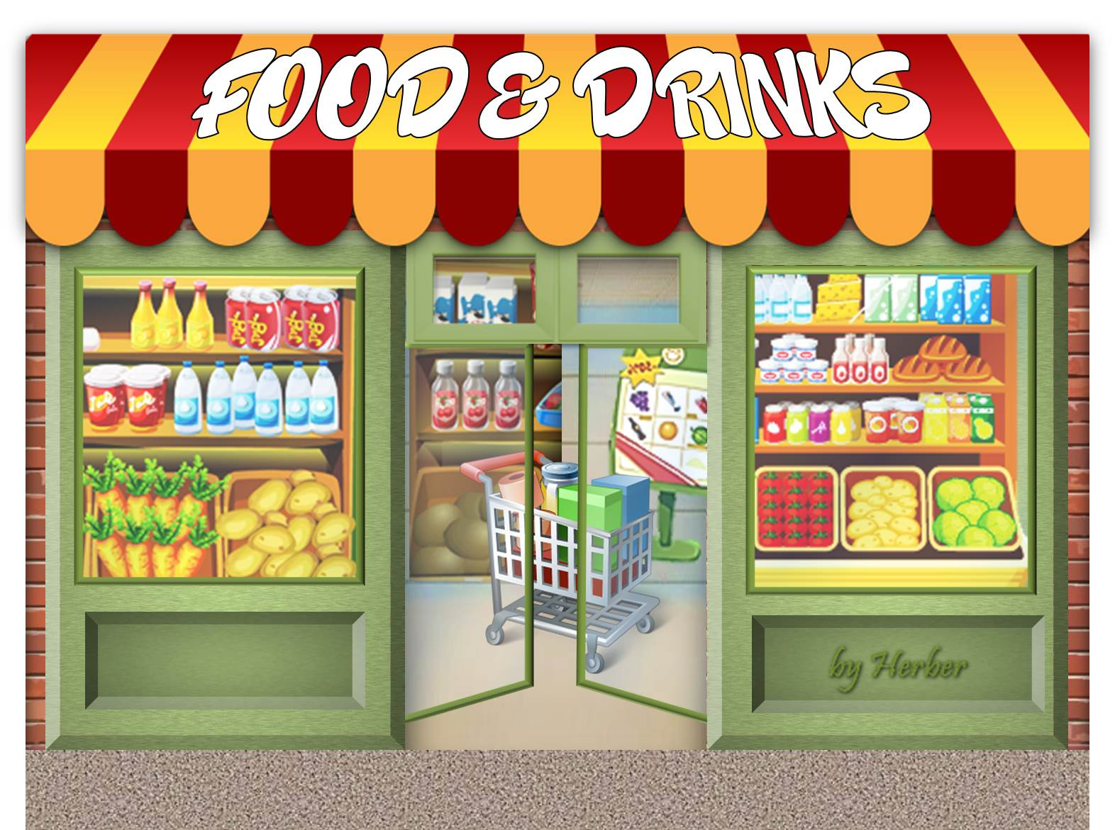
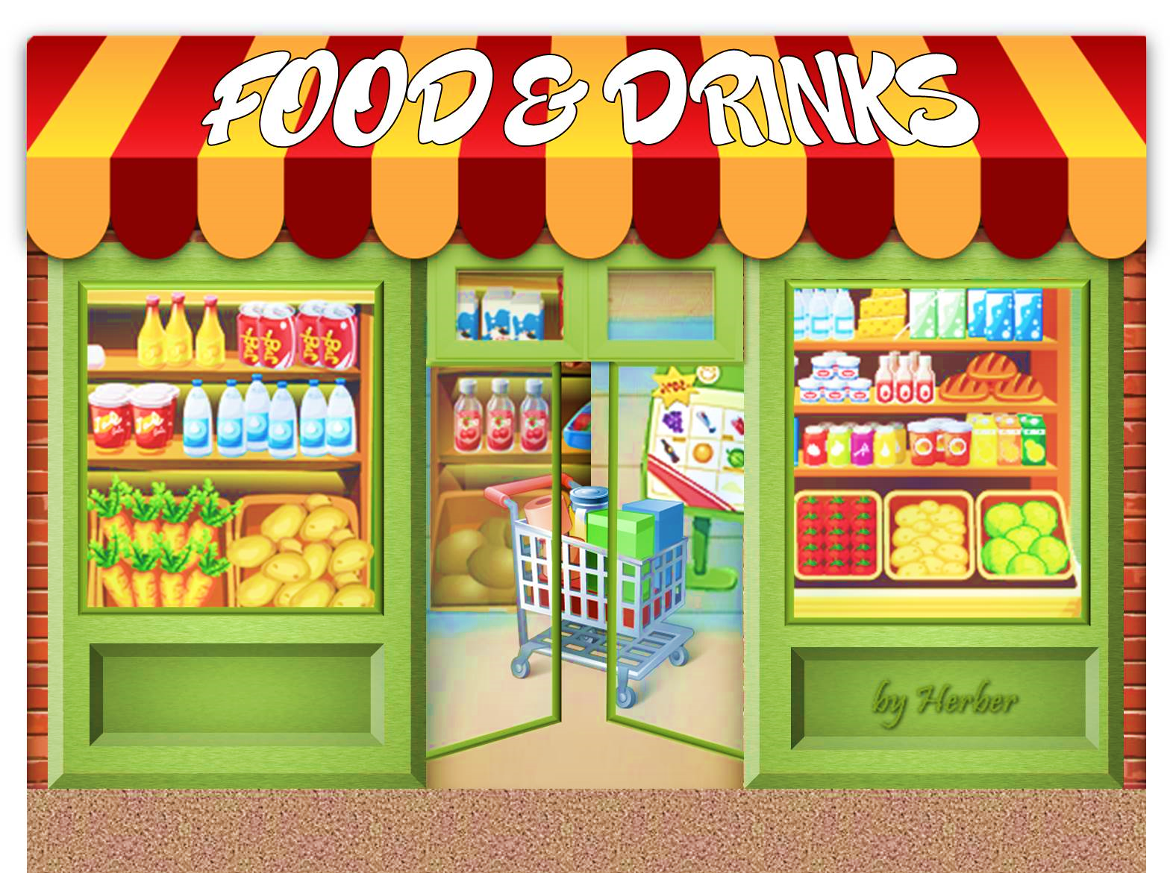



Slide 2





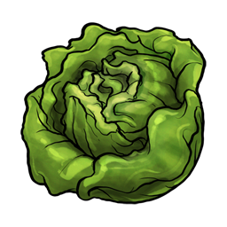
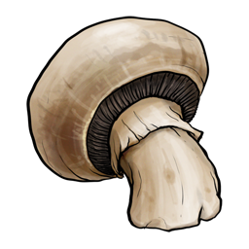






vegetables
carrot
cucumber
garlic
lettuce
mushroom
onion
pepper
potato
pumpkin
tomato
Click on the pictures to show the words

Slide 3











fruit
apple
banana
cherry
grapes
lemon
orange
peach
pear
strawberry
watermelon
Click on the pictures to show the words

Slide 4



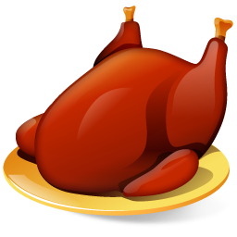
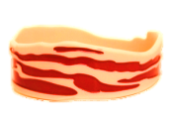









meat
beef
lamb
pork
bacon
chicken
ham
meatballs
ribs
sausages
steak
Click on the pictures to show the words

Slide 5







fish & seafood
clams
mussels
octopus
prawn
salmon
sardines
tuna
Click on the pictures to show the words

Slide 6








dairy products
butter
cheese
cream
ice cream
milk
milkshake
yoghurt
Click on the pictures to show the words

Slide 7







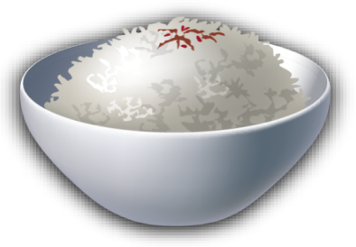
cereal
biscuit
bread
cereal
corn
flour
pasta
rice
wheat
Click on the pictures to show the words

Slide 8


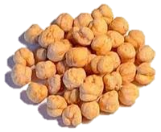



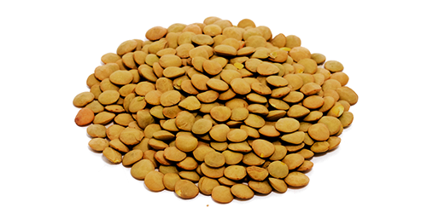
legumes
beans
chickpeas
green beans
lentils
peas
Click on the pictures to show the words

Slide 9
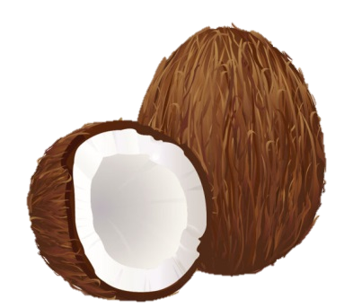

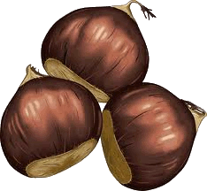



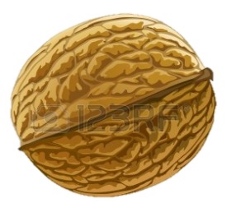
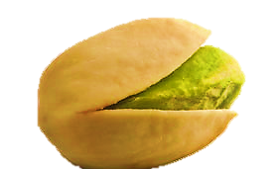

nuts
almond
cashew
chestnut
coconut
hazelnut
pistachio
peanut
walnut
Click on the pictures to show the words

Slide 10

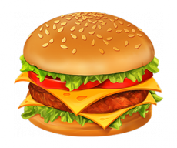


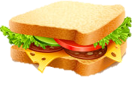
fast food
candy bar
chips
hamburger
hot dog
pizza
sandwich
Click on the pictures to show the words

Slide 11





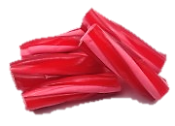
sweets
cake
chewing gum
jelly beans
liquorice
lollipop
sweet/candy
Click on the pictures to show the words

Slide 12



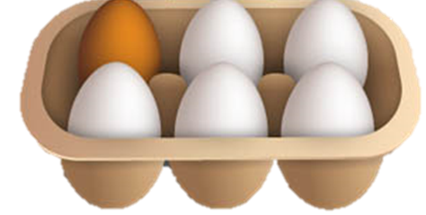





other food
eggs
jam
ketchup
mayonnaise
mustard
olive oil
salt
sugar
vinegar
Click on the pictures to show the words

Slide 13









drinks
beer
coffee
hot chocolate
orange juice
soft drink
tea
water
wine
Click on the pictures to show the words

Slide 14

food prices
£5.65/Kg
£6.67/Kg
30 p
£2.50/Kg
£1.50/Kg
£1.99
£5.25
£1.59
£1.29/Kg
£1.95
How much is the cheese?
It’s five pounds sixty-five (pence).
CHECK

Slide 15
food prices
£5.65/Kg
£6.67/Kg
30 p
£2.50/Kg
£1.50/Kg
£1.99
£5.25
£1.59
£1.29/Kg
£1.95
How much is the garlic?
It’s thirty pence.
CHECK

Slide 16
food prices
£5.65/Kg
£6.67/Kg
30 p
£2.50/Kg
£1.50/Kg
£1.99
£5.25
£1.59
£1.29/Kg
£1.95
How much are the eggs?
They are one pound ninety-five (pence).
CHECK

Slide 17
food prices
£5.65/Kg
£6.67/Kg
30 p
£2.50/Kg
£1.50/Kg
£1.99
£5.25
£1.59
£1.29/Kg
£1.95
How much are the grapes?
They are two pounds fifty (pence).
CHECK

Slide 18
food prices
£5.65/Kg
£6.67/Kg
30 p
£2.50/Kg
£1.50/Kg
£1.99
£5.25
£1.59
£1.29/Kg
£1.95
How much are the hazelnuts?
They are five pounds twenty-five (pence).
CHECK

Slide 19
food prices
£5.65/Kg
£6.67/Kg
30 p
£2.50/Kg
£1.50/Kg
£1.99
£5.25
£1.59
£1.29/Kg
£1.95
How much are the mussels?
They are six pounds sixty-seven (pence).
CHECK

Slide 20
food prices
£5.65/Kg
£6.67/Kg
30 p
£2.50/Kg
£1.50/Kg
£1.99
£5.25
£1.59
£1.29/Kg
£1.95
How much is the ham?
It’s one pound ninety-nine (pence).
CHECK

Slide 21
food prices
£5.65/Kg
£6.67/Kg
30 p
£2.50/Kg
£1.50/Kg
£1.99
£5.25
£1.59
£1.29/Kg
£1.95
How much are the peas?
They are one pound fifty (pence).
CHECK

Slide 22
food prices
£5.65/Kg
£6.67/Kg
30 p
£2.50/Kg
£1.50/Kg
£1.99
£5.25
£1.59
£1.29/Kg
£1.95
How much is the rice?
It’s one pound twenty-nine (pence).
CHECK

Slide 23
food prices
£5.65/Kg
£6.67/Kg
30 p
£2.50/Kg
£1.50/Kg
£1.99
£5.25
£1.59
£1.29/Kg
£1.95
How much is the jam?
It’s one pound fifty-nine (pence).
CHECK
EXIT

